Slide 1
Compiler Design 14CS73
Teaching Faculty
Dr. Saroja Devi H.
Professor, Dept.of CSE, NMIT
Text book: Compilers, Techniques, and Tools
(Second Edition), Aho, Lam, Sethi, and
Ullman, Addison-Wesley, Pearson education,2007
Ref:https://nptel.ac.in/downloads/106108113/

Slide 2
Overview
Language Processors
Structure of Compiler with illustration
Compiler Construction tools
Science of building a compiler
Applications of compiler technology
Basics of lexical analysis

Slide 3
Introduction
Programming languages are notations for denoting computations to people and to machines.
Compilers are the software systems that do the translation of programming languages to machine languages and report errors in this process.
Compiler is a type of language processor that can read a program in one language (source language) and translate into an equivalent program in another language (target language)

Slide 4
Why study Compiler Design?
Computational thinking in language design
Understanding how modern language and compiler technology can be used to make software reliably, securely, and efficiently
Motivation for new programming languages such as GO (https://golang.org) and Clojure (https://clojure.org/)
Understanding modern program translation techniques and tools
Awareness of language and compiler issues in dealing with parallelism and concurrency
Get experience on a project in which you can explore in some depth an advanced topic in programming languages and compilers of your own choosing.

Slide 5
Language Processor
Source program
Target Program
Faster
Limited error diagnostics
Compiler
Errors
If the target program is an executable machine language program it can be called by the user to process inputs producing outputs.
Input
Output
Target Program
Running the target program
Interpreter directly executes the operations (one by one) specified in the source program on inputs supplied by the user.
Source program
Output
Slower
Better error diagnostics
Interpreter
Input
Errors

Slide 6
Compilers and Interpreters
Compilers generate machine code, whereas interpreters
interpret intermediate code.
Interpreters are easier to write and can provide better error
messages (symbol table is still available).
Interpreters are at least 5 times slower than machine code
generated by compilers.
Interpreters also require larger memory than machine
code generated by compilers.
Examples of interpreter: Perl, Python, Unix Shell, Java, BASIC, LISP

Slide 7
A Hybrid Compiler
Java language processors combine compilation & interpretation
Source program
Translator
Virtual
Machine
(byte code) Intermediate program
Output
Input

Slide 8
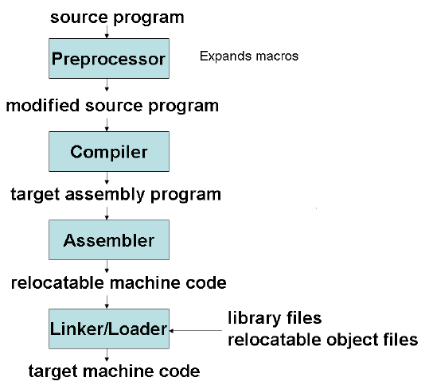
Language Processing System
A preprocessor collects modules of source program from files, expands shortcuts, & macros.
Compiler processes the modified source program and produces assembly language program.
Assembler produces relocatable machine code as its output.
Linker revolves external memory addresses, where code in one file may refer to a location in another file.
Loader puts all executable object files into memory.
Notes:
Since larger programs are compiled in pieces, the relocatable machine code must be linked together with other codes to run on machine.

Slide 9
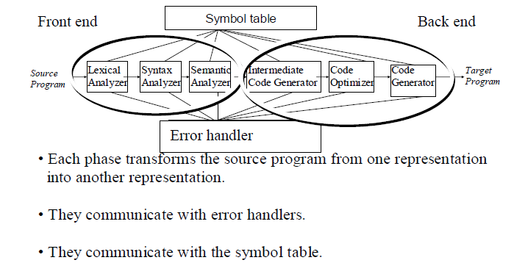
Phases of a Compiler

Slide 10
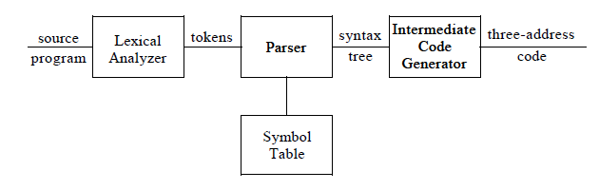
Front End

Slide 11
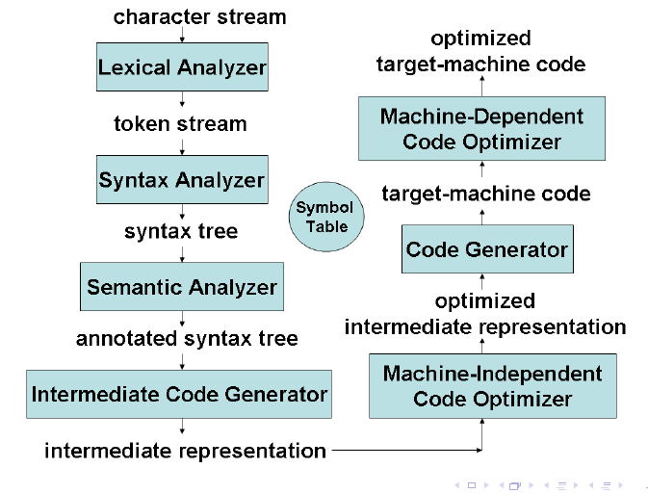
Structure of a Compiler

Slide 12
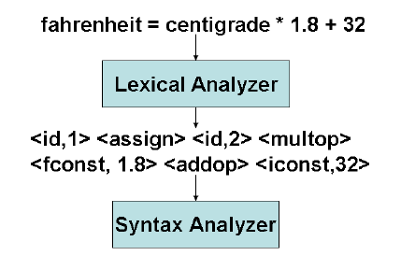
Lexical Analysis (LA)
Note: Fahrenheit and centigrade are lexemes mapped into tokens <id,1> and <id,2> resp.
*is a lexeme mapped to token <multop> or <*>

Slide 13
Lexical Analysis
LA can be generated automatically from regular expression specifications
LEX and Flex are two such tools
LA is a deterministic finite state automaton
Why is LA separate from parsing?
Simplification of design - software engineering reason
I/O issues are limited to LA alone
LA based on finite automata are more efficient to implement than pushdown automata used for parsing (due to stack)

Slide 14
Syntax Analysis or Parsing
Syntax analyzers (parsers) can be generated automatically from several variants of context-free grammar specifications
LL(1), and LALR(1) are the most popular ones
ANTLR (for LL(1)), YACC and Bison (for LALR(1)) are such tools
Parsers are deterministic push-down automata
Parsers cannot handle context-sensitive features of programming languages; e.g.,
Variables are declared before use
Types match on both sides of assignments
Parameter types and number match in declaration and use

Slide 15
Grammars are Used for Specifying Syntax
The grammar S → aSbS | bSaS | ε generates all strings of a’s and b’s with the same number of a’s as b’s.
This grammar is ambiguous: abab has two parse trees.
S
S
a
S
b
S
a
S
b
S
b
S
a
S
ε
ε
a
S
b
S
ε
ε
ε
ε
(ab)^{n} has parse trees

Slide 16
Programming Languages are not Inherently Ambiguous
This grammar G generates the same language
S → aAbS | bBaS | ε
A → aAbA | ε
B → bBaB | ε
G is unambiguous and has
only one parse tree for
every sentence in L(G).
S
a
A
b
S
ε
a
A
b
S
ε
ε

Slide 17
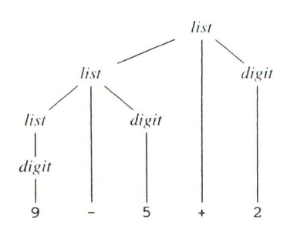
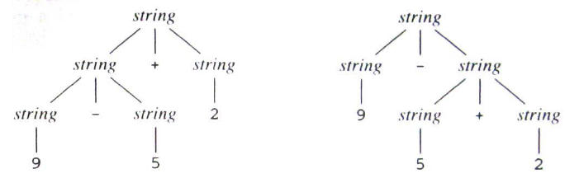
Illustration
Grammar:
list -> list + digit | list - digit | digit
digit -> 0|1|2|3|4|5|6|7|8|9
Parse tree for 9-5+2 ---------------->
Two parse trees as below (ambiguous)

Slide 18
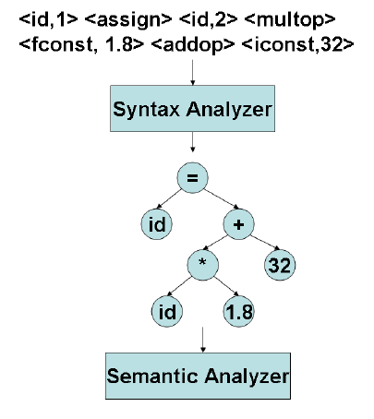
Syntax Analysis: method
Produces syntax tree that describes the syntactic structure

Slide 19
Semantic Analysis
Semantic consistency that cannot be handled at the parsing stage is handled here
Type checking of various programming language constructs is one of the most important tasks
Stores type information in the symbol table or the syntax tree
Types of variables, function parameters, array dimensions, etc.
Used not only for semantic validation but also for subsequent phases of compilation
Static semantics of programming languages can be specified using attribute grammars

Slide 20
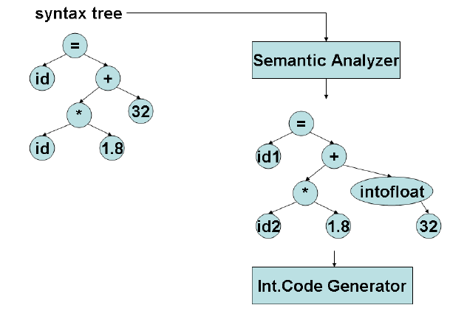
Semantic analysis: Illustration

Slide 21
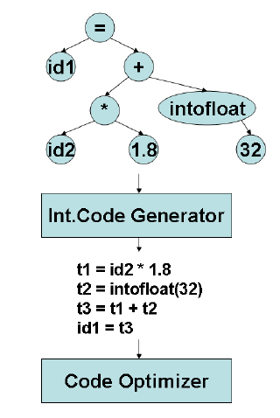
Intermediate Code generation
Using the syntax tree form, intermediate code is generated, which is low level machine like intermediate representation.
Intermediate form of 3 address code which is like assembly like instruction is produced.

Slide 22
Intermediate Code generation
While generating machine code directly from source code is possible, it entails two problems
With m languages and n target machines, we need to write mxn compilers
The code optimizer which is one of the largest and very-difficult-to-write components of any compiler cannot be reused
By converting source code to an intermediate code, a machine-independent code optimizer may be written
Intermediate code must be easy to produce and easy to translate to machine code
A sort of universal assembly language
Should not contain any machine-specific parameters (registers, addresses, etc.)

Slide 23
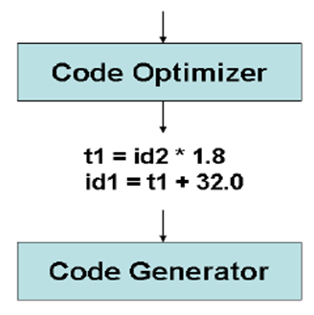
Code Optimization (machine independent)
t1 = id2 * 1.8
t2 = inttofloat(32)
t3 = t1+t2
id1 = t3
Improves intermediate code so that better target code is generated.
Better means faster execution, shorter code, or target that consumes less power.
Inttofloat can be done in compile time, so no need of doing it again. Instead replace it with floating point number 32.0
Variable t3 is redundant. Avoiding it can result in shorter sequence.

Slide 24
Machine Independent Code Optimization
Intermediate code generation process introduces many inefficiencies
Extra copies of variables, using variables instead of constants, repeated evaluation of expressions, etc.
Code optimization removes such inefficiencies and improves code
Improvement may be time, space, or power consumption
It changes the structure of programs, sometimes of beyond recognition
Inlines functions, unrolls loops, eliminates some programmer-defined variables, etc.
Code optimization consists of a bunch of heuristics and percentage of improvement depends on programs (may be zero also.)

Slide 25
Examples of Machine Independent optimizations
Common sub-expression elimination
Copy propagation
Loop invariant code motion
Partial redundancy elimination
Induction variable elimination and strength reduction
Code optimization needs information about the program
which expressions are being recomputed in a function?
which definitions reach a point?
All such information is gathered through data-flow analysis

Slide 26
Code Generation
Converts intermediate code to machine code
Each intermediate code instruction may result in many machine instructions or vice-versa
Must handle all aspects of machine architecture Registers, pipelining, cache, multiple function units, etc.
Generating efficient code is an NP-complete problem
Tree pattern matching-based strategies are among the best
Needs tree intermediate code
Storage allocation decisions are made here
Register allocation and assignment are major issues
First operand specifies destination; F indicates floating point representation
t1=id2*1.8
id1=t1+32.0
Code Generator
LDF R2, id2
MULF R2,R2, #1.8
ADDF R2,R2, #32.0
STF id1, R2

Slide 27
Machine dependent optimizations
Peephole optimizations
Analyze sequence of instructions in a small window (peephole) and using preset patterns, replace them with a more efficient sequence
Redundant instruction elimination e.g., replace the sequence [LD A,R1][ST R1,A] by [LD A,R1]
Eliminate “jump to jump” instructions
Use machine idioms (use INC instead of LD and ADD)
Instruction scheduling (reordering) to eliminate pipeline interlocks and to increase parallelism
Trace scheduling to increase the size of basic blocks and increase parallelism
Software pipelining to increase parallelism in loops

Slide 28
Symbol table management
Symbol table is a data structure containing a record for each variable, with fields for the attributes of the name.
Entry for an identifier holds information about the identifier like, name and type.
Assignment symbol is a keyword and does not need attributes for the token <=>
This must allow fast store & retrieval of data
1 | fahrenheit
2 | centigrade
3
4

Slide 29
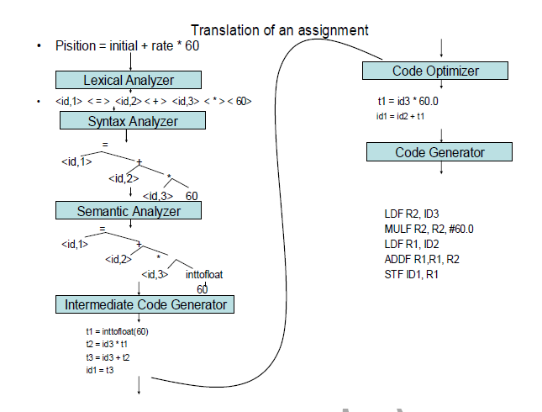
Another Example

Slide 30
Compiler Construction Tools
Modern software development environments containing tools such as language editors, debuggers, version managers, profilers, test harnesses.
Specialized tools to implement compilers:
1. Parser generators that automatically produce syntax analyzers from a grammatical description of a programming language.
2. Scanner generators that produce lexical analyzers from a regular-expression description of the tokens of a language.
3. Syntax-directed translation engines that produce collections of routines for walking a parse tree and generating intermediate code.
4. Code-generators that produce a code generator from a collection of rules for translating each operation of the intermediate language into the machine language for a target machine.
5. Data-flow analysis engines that facilitate the gathering of information about how values are transmitted from one part of a program to each other part. Data-flow analysis is a key part of code optimization.
6. Compiler-construction toolkits that provide an integrated set of routines for constructing various phases of a compiler.

Slide 31
Science of Building a Compiler
The problem formulation must be grounded in a solid understanding of the characteristics of computer programs, and the solution must be validated and refined empirically.
A compiler must accept all source programs that conform to the specification of the language; the set of source programs is infinite and any program can be very large, consisting of possibly millions of lines of code.
Any transformation performed by the compiler while translating a source program must preserve the meaning of the program being compiled.
Compiler writers thus have influence over not just the compilers they create, but all the programs that their compilers compile.
This leverage makes writing compilers particularly rewarding; however, it also makes compiler development challenging.
Two aspects to deal mainly: Modeling in Compiler Design and Implementation & Code optimization

Slide 32
Science of building compiler: Modeling
Designing the right mathematical models and choosing the right algorithms, while balancing the need for generality and power against simplicity and efficiency.
finite-state machines, regular expressions, context-free grammars and trees : are the models
These models are useful for describing the lexical units of programs (keywords, identifiers, and such) and for describing the algorithms used by the compiler to recognize those units.
Another model, context-free grammars, used to describe the syntactic structure of programming languages such as the nesting of parentheses or control constructs.
Trees are models for representing the structure of programs and their translation into object code.

Slide 33
Science of building compiler : The Science of Code Optimization
Optimization => more efficient code
complex because processor architectures have become more complex.
Important because massively parallel computers require substantial optimization, or their performance suffers by orders of magnitude. With the likely prevalence of multicore machines these need to take advantage of multiprocessing with the help of compilers.
Models such as graphs, matrices, and linear programs are needed for optimizing the code.
Notes:
Multicore=> computers with chips that have large numbers of processors on them

Slide 34
Design objectives of code optimization
The optimization must be correct, that is, preserve the meaning of the compiled program.
The optimization must improve the performance of many programs: performance means the speed of the program execution; in embedded applications, we may also wish to minimize the size of the generated code. In mobile devices, it is desirable that the code minimizes power consumption. Typically, the same optimizations that speed up execution time also conserve power. Besides performance, error reporting and debugging are also important.
The compilation time must be kept reasonable to support a rapid development and debugging cycle. Testing optimized code takes more time.
The engineering effort required must be manageable: prioritize the optimizations, implementing only those that lead to the greatest benefits.

Slide 35
Applications of Compiler Technology
Implementation of High-Level Programming Languages
Optimizations for Computer Architectures
Design of New Computer Architectures
Program Translations
Software Productivity Tools

Slide 36
1.Implementation of high level languages
High-level programming language defines a programming abstraction that may be inefficient
The programmer expresses an algorithm using the language, and the compiler must translate that program to the target language.
Generally, higher-level programming languages are easier to program, however are less efficient, that is, the target programs run more slowly.
Challenges : object orientation (data abstraction & inheritance of properties) , compiler optimizations (Java etc.), supporting portable & mobile code

Slide 37
2.Optimizations for Computer Architecture
Parallelism: at instruction level and at processor level; compilers can rearrange the instructions to make the instruction level parallelism more effective.
Memory hierarchy: to get fast and large storage

Slide 38
Parallelism
VLIW (very long instruction word) machines have instructions that can issue multiple operations in parallel with the help of compilers. It works on vector of data.Ex: Intel IA64.
Multiprocessors: Multiple processors in a single computer can run multiple threads in a program. A compiler generates such parallel code, hides the details of finding parallelism, reduces communication & synchronization overhead.

Slide 39
Memory Hierarchies
Memory hierarchy has several levels of storage with different speeds and sizes.
Level closest to the CPU is fastest.
The average memory access time is reduced if most of the accesses are satisfied by the faster levels, thus improving the performance.
Compiler helps in this optimization: changing the data layout , reorganizing instruction order, changing code layout etc.improves the cache management .

Slide 40
3.Design of a new Computer Architecture
RISC: PowerPC, SPARC, MIPS(Microprocessor without Interlocked Pipeline Stages), PA RISC, X86 architecture is CISC but uses RISC concepts
Specialized architecture: VLIW, SIMD, AMD multicore processors, GPU architectures and IBM Power7 processor with multimedia instruction processing, embedded machine, single chip architecture to achieve cost effectiveness.
Compiler technology is needed to support programming for these architectures and to evaluate the architectural design.

Slide 41
4. Program translations
These involve Translation between different kinds of languages.
Binary translation: binary code of one machine to binary code of another. Ex: x86 code to VLIW code
Hardware synthesis: Hardware design descriptions in Verilog or VHDL (very high speed integrated circuit hardware description lang.) Hardware descriptions are in Register transfer level(RTL) where variables represent registers and expressions represent combinational logic. RTL leads to gates, transistors, and physical layouts. The software tools provide specifications, optimize the circuits, translate designs from one level to another etc.
Database query interpreters SQL(structured query language) are used for searching databases. The queries comprise of predicates containing relational and Boolean operators. These can be interpreted or compiled.
Compiled simulation: Design simulators that interpret a design, are expensive, but provide many design alternatives. Instead of writing a simulator, that interprets the design, it is faster to compile the design to produce machine code. Compiled simulation is used in Verilog/VHDL that simulate the designs.

Slide 42
5.Software productivity tools
Program errors affect the productivity, leading system crash, vulnerability to security threats etc. Testing can locate errors in programs, for which static program analysis tools based on data flow analysis are developed using compiler related techniques, as below.
Type checking
Bounds checking
Memory management tools
(Contd..)

Slide 43
Type checking
Effective and well-established technique
Can catch errors, for example,
where an operation is applied to the wrong type of object, or
if parameters passed to a procedure do not match the signature of the procedure.
if a pointer is assigned null and then immediately dereferenced
Can catch a variety of security holes
an attacker supplies a string or other data that is used carelessly by the program. A user-supplied string can be labeled with a type "dangerous." If this string is not checked for proper format, then it remains "dangerous," and if a string of this type is able to influence the control-flow of the code at some point in the program, then there is a potential security flaw.

Slide 44
Bounds Checking
Buffer overflow and array out of bound are major problems in coding.
Many security breaches in systems are caused by buffer overflows in programs written in C.
Techniques have been developed to find buffer overflows in programs, but with limited success.
C does not have array bounds checks; With automatic range checking, buffer overflow does not occur. This problem causes small runtime cost. The same data flow analysis that is used to eliminate redundant range checks can also be used to locate buffer overflows.
Tracking the values of pointers across procedures, are needed to get high-quality results in error detection tools.

Slide 45
Memory management tools
Garbage collection is another excellent example of the tradeoff between efficiency and a combination of ease of programming and software reliability.
Automatic memory management obliterates all memory-management errors (e.g., "memory leaks"), which are a major source of problems in C and C + + programs.
Various tools have been developed to help programmers find memory management errors. For example, Purify is a widely used tool that dynamically catches memory management errors as they occur.
Tools that help identify some of these problems statically have also been developed.

Slide 46
Lexical Analysis
A lexical analyzer reads characters from the input and groups them into "token objects.“
Along with a terminal symbol that is used for parsing decisions, a token object carries additional information in the form of attribute values.
A sequence of input characters that comprises a single token is called a lexeme.

Slide 47
The Role of Lexical Analyser
token
Source
program
Lexical Analyzer
Parser
To semantic
analysis
getNextToken
Symbol
table
Commonly, the interaction is implemented by having the parser call the lexical analyzer. The call, suggested by the getNextToken command, causes the lexical analyzer to read characters from its input until it can identify the next lexeme and produce for it the next token, which it returns to the parser.

Slide 48
Tasks of Lexical analyser
The main task is to read the input characters of the source program, group them into lexemes, and produce as output a sequence of tokens for each lexeme in the source program.
The stream of tokens is sent to the parser for syntax analysis.
The lexical analyzer has to interact with the symbol table also. On discovering a lexeme constituting an identifier, it needs to enter that lexeme into the symbol table.

Slide 49
The Other tasks of lexical analyser
One task is separating out comments and whitespace (blank, newline, tab, and perhaps other characters that are used to separate tokens in the input).
Another task is correlating error messages generated by the compiler with the source program. For instance, the lexical analyzer may keep track of the number of newline characters seen, so it can associate a line number with each error message. In some compilers, the lexical analyzer makes a copy of the source program with the error messages inserted at the appropriate positions.
If the source program uses a macro-preprocessor, the expansion of macros may also be performed by the lexical analyzer.

